Slide 1

EARLY WARNING FOR PRE AND POST FLOOD RISK MANAGEMENT
U. U. Samantha Rajapaksha
S. P. M. K. W. Ilukkumbure, V. Y. Samarasiri,
M. F. Mohamed, V. Selvaratnam
Department of Information Technology, Faculty of Computing
Sri Lanka Institute of Information and Technology
Notes:
Hello 👋 Everyone,
I am Kaveesha Ilukkumbure
Our Research Topic is
EARLY WARNING FOR
PRE AND POST FLOOD RISK MANAGEMENT
And My Co-Authors are Mr. Samantha Rajapaksha
Vidura Samarasiri
M. Fazil Mohomad
V . Selvaratnam
We are from Faculty of Computing,… Sri Lanka Institute of Information & Technology

Slide 2
Introduction
Notes:
Let’s move into Introduction
First of all, our research Background.

Slide 3
Background
Flooding and landslides have been a very treacherous situation in Sri Lanka where many areas are flooded by the slightest rain.
Flooding happens due to various reasons, such as man-made and natural causes.
According to the Disaster Management Centre (DMC) situation report, as of 8 December 2020, 111,659 people (33,316 families) have been affected across 14 districts. (IFRC, 13 Dec 2020)
Notes:
Background
Flooding and landslides have been a very treacherous situation in Sri Lanka where many areas are flooded by the slightest rain.
Flooding happens due to various reasons such as human and natural reasons.
As an example, 8th of December 2020, there was a flooding, affecting 14 districts with displacing huge number of individuals.

Slide 4
Problem Identification
Unavailability of an early warning mechanism or method.
When a flooding situation occurs, it results in loss of human lives, property losses, agricultural losses, and economic losses.
Due unadvanced system, poor coordination between people and the officials increase the flood disaster loses and recovery plans are delayed.
Notes:
So, with this we identified major problems,
Unavailability of an early warning mechanism or method.
Flooding occurs, it results in loss of human lives, property losses, agricultural losses, and economic losses.
Poor communication with authorities results in increment of flood damages and delays in recovery plans.

Slide 5
Existing Work
Geo-enabled FOSS tool supports for immediate flood disaster response planning. [1]
Predicting Floods in North Central Province of Sri Lanka using Machine Learning and Data Mining Methods. [2]
Crisis mapping and crowdsourcing in flood management. [3]
A smart weather station based on sensor technology. [4]
Notes:
When we investigate related work.
One of the leading research team had conducted immediate response planning and relief support tool.
Another by
Flood Prediction using machine learning models.
Crisis mapping by crowdsourcing.
Using sensors for weather monitoring.

Slide 6
Solution
Comprehensive analysis on utilizing IoT devices for weather prediction.
Analyze 3rd party API solutions and provide real-time weather information and develop Proof-of-Concept to verify the accuracy of weather information.
Usage of data Mining algorithms for the rainfall and flood predictions based on historic data analysis.
The implementation of the solution with comply of a web application and mobile application to visualize the finalized data for the end users based on their needs.
Notes:
Then planned our solutions for a selected area.
Utilizing IoT devices for weather prediction.
Verify weather data with third party APIs and real-time data.
Using data mining algorithms for rainfall and flood prediction with historical data.
Creating end user applications for collect crowdsourcing data and visualize reports.

Slide 7
Components
IoT Devices
Crowdsourcing
Rainfall-Forecasting
Flood-Forecasting
Notes:
Then let's look at our identified components.
It consists of
IoT Device
Crowdsourcing
Rainfall-Forecasting
Flood-Forecasting

Slide 8

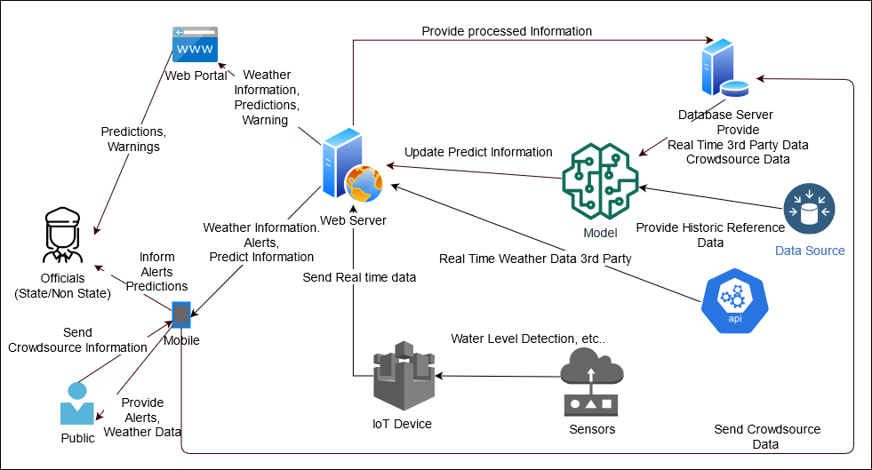
Overall System Diagram
Notes:
This is our Overall System Diagram.

Slide 9

Internet of Things
Notes:
Then lets we talk out IoT.

Slide 10
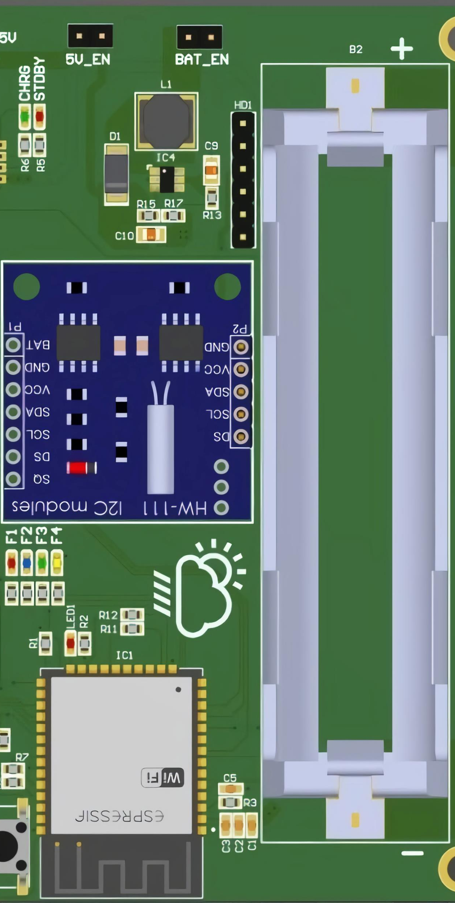
IoT Methodology
The IoT Device perspective consists of 2 major parts
Implementation a smart weather monitoring device.
Non-Subscribed users can receive weather data information.
Implementation a smart weather monitoring device
Weather monitoring is done with the help of IoT sensors.
Gathered weather data are being Ingested with the help of an ESP32 module.
Non-Subscribed users to be able to receive weather data information.
Users could receive weather information despite of access to the applications.
Notes:
Our IoT Methodology Consists of 2 major parts,
First
Implementation a smart weather monitoring device.
IoT Sensor will collect data. And Collected Data weather data is Ingested with the help of an ESP32 module.
Second
And providing Non-Subscribed users weather data information.
Users could receive weather information despite of access to the applications.

Slide 11
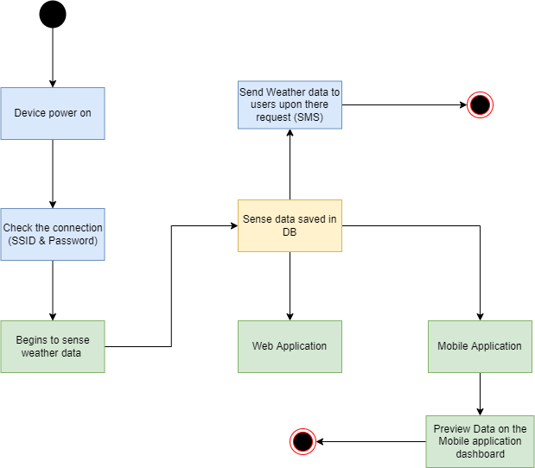
Device Functionality Flow
Notes:
So, this our Device Functionality flow.

Slide 12
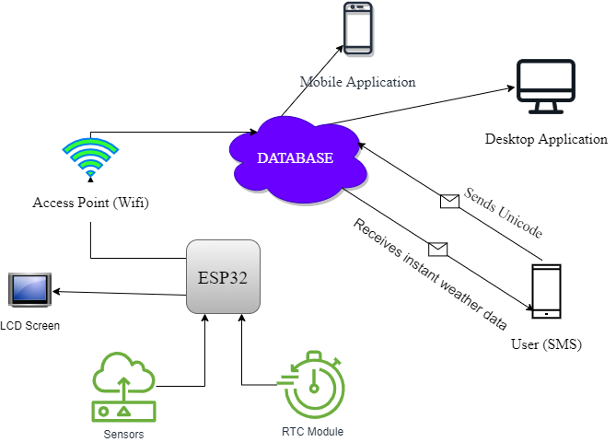
IoT High-Level Component Diagram
Notes:
This IoT component high level diagram .

Slide 13

Crowdsourcing
Notes:
Moving on to Crowdsourcing component.

Slide 14
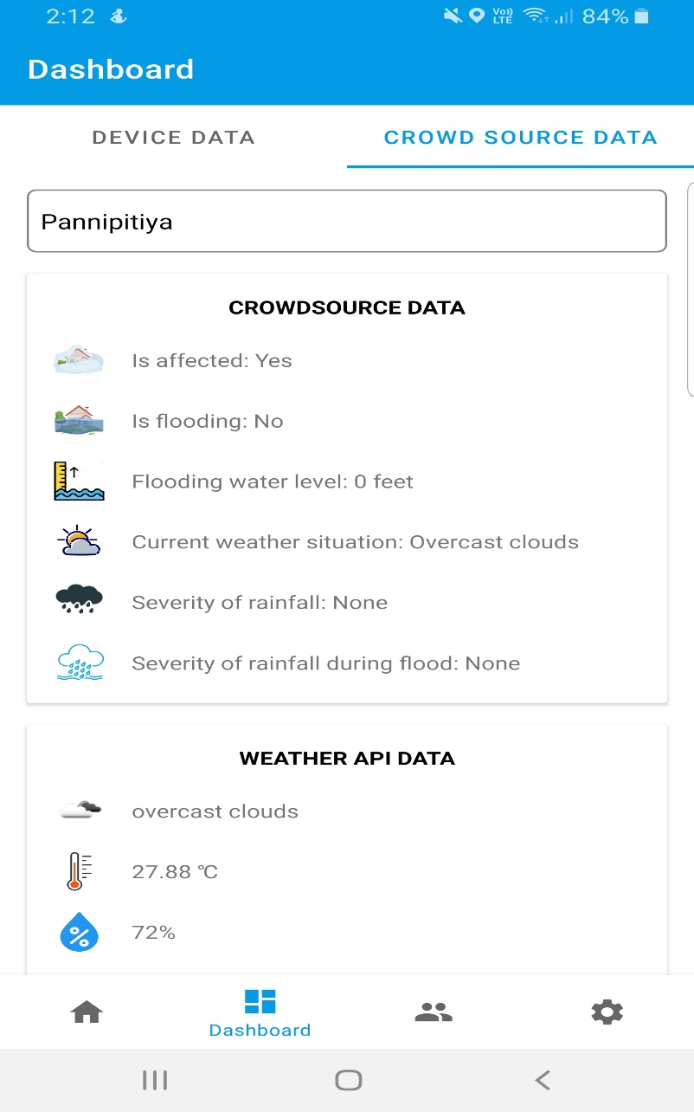
Crowdsource Methodology
Gather weather information from the crowd
Information gathered through set of questionaries
Impacted location is automatically captured through Mobile geo-location feature.
Notes:
Our crowdsourcing Methodology Consists of 2 major parts,
Information gathered through set of questionaries
Impacted location is automatically captured through Mobile location feature.

Slide 15
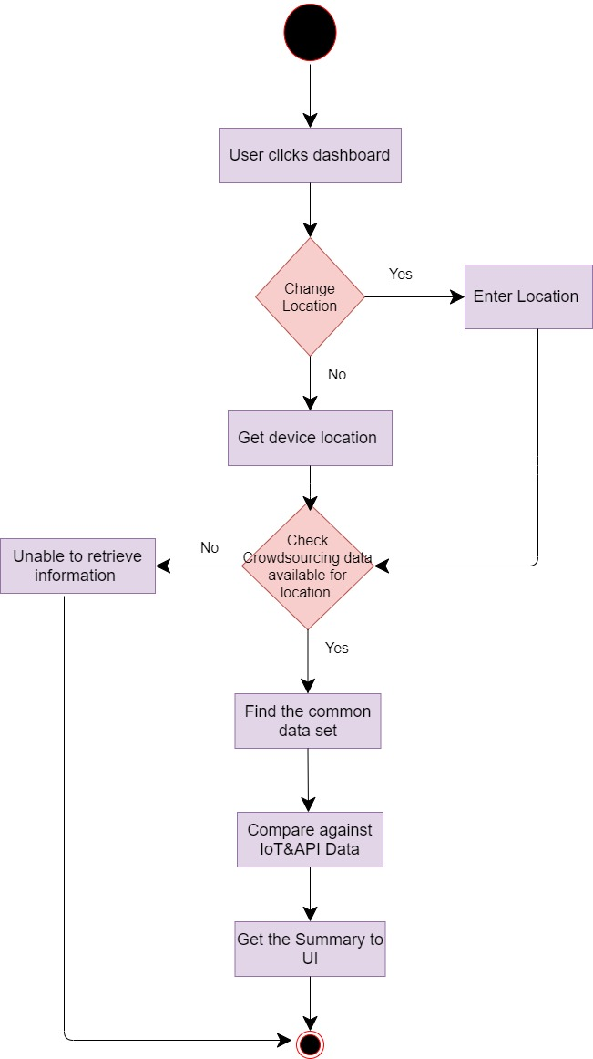
Data Manipulation Flow
Notes:
And this our data manipulation flow of gathered crowdsourcing data.

Slide 16
Rainfall-forecasting
Notes:
Then let's move on to Rainfall-forecasting component.

Slide 17
Factors contribute for
Notes:
They are main factors contribute for rainfall.
Which are
temperature.
Relative humidity
Sea-level pressure and others

Slide 18
Research Methodology Daily Data(2015-2019)
Rainfall
Temperature Maximum
Relative Humidity Minimum
Sea Level pressure Average.
Data had collected from 3 different weather stations
Colombo
Katugastota
Vavuniya
from Meteorology Department of Sri Lanka.
Notes:
The research methodology of rain-fall forecasting component used previously mentioned factors on 3 different weather stations.
Colombo
Katugasthota
Vavuniya
And these data is collected by metrology department of sri lanka.

Slide 19
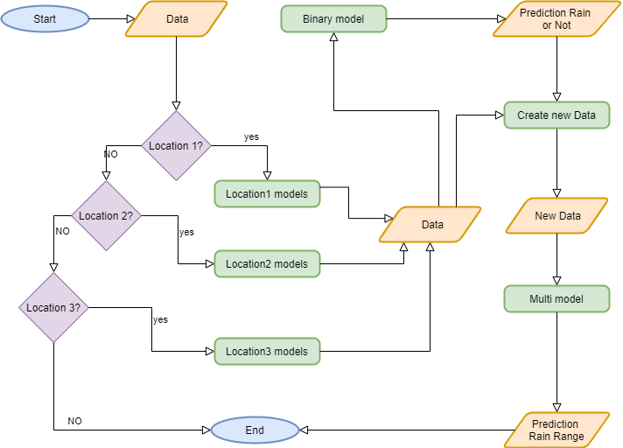
Prediction Process
Notes:
This is the rainfall prediction flow.
for each location classified prediction for rain for status and rainfall range.

Slide 20
Flood-forecasting
Notes:
Then let's move on to final component. Flood forecasting.

Slide 21
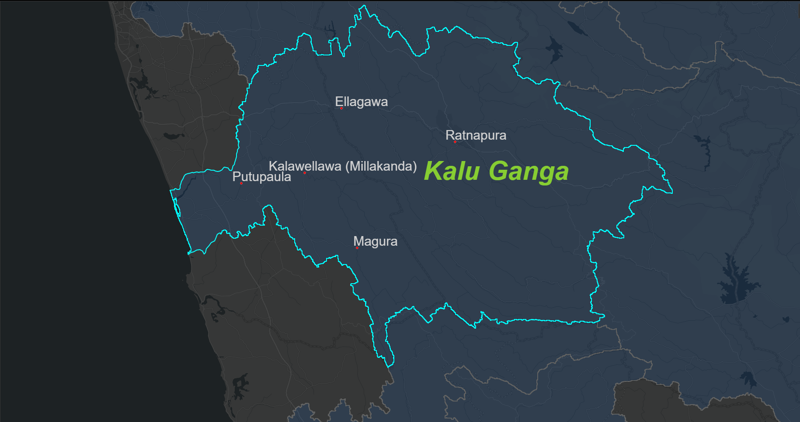
Study Area in Research
Ellagawa
Kalawellawa (Millakanda)
Magura
Putupaula
Ratnapura
Why?
Suitable for Poof-Of-Concept
Urban Areas
Riverside Areas
Availability of Riverside data
Kalu River Basin
Notes:
We selected a study area as Kalu River Basin and Gathered data form these 5 stations from the irrigation department.
We selected this area because it is consisted of
Urban Areas
Riverside areas
And Availability of riverside data.

Slide 22
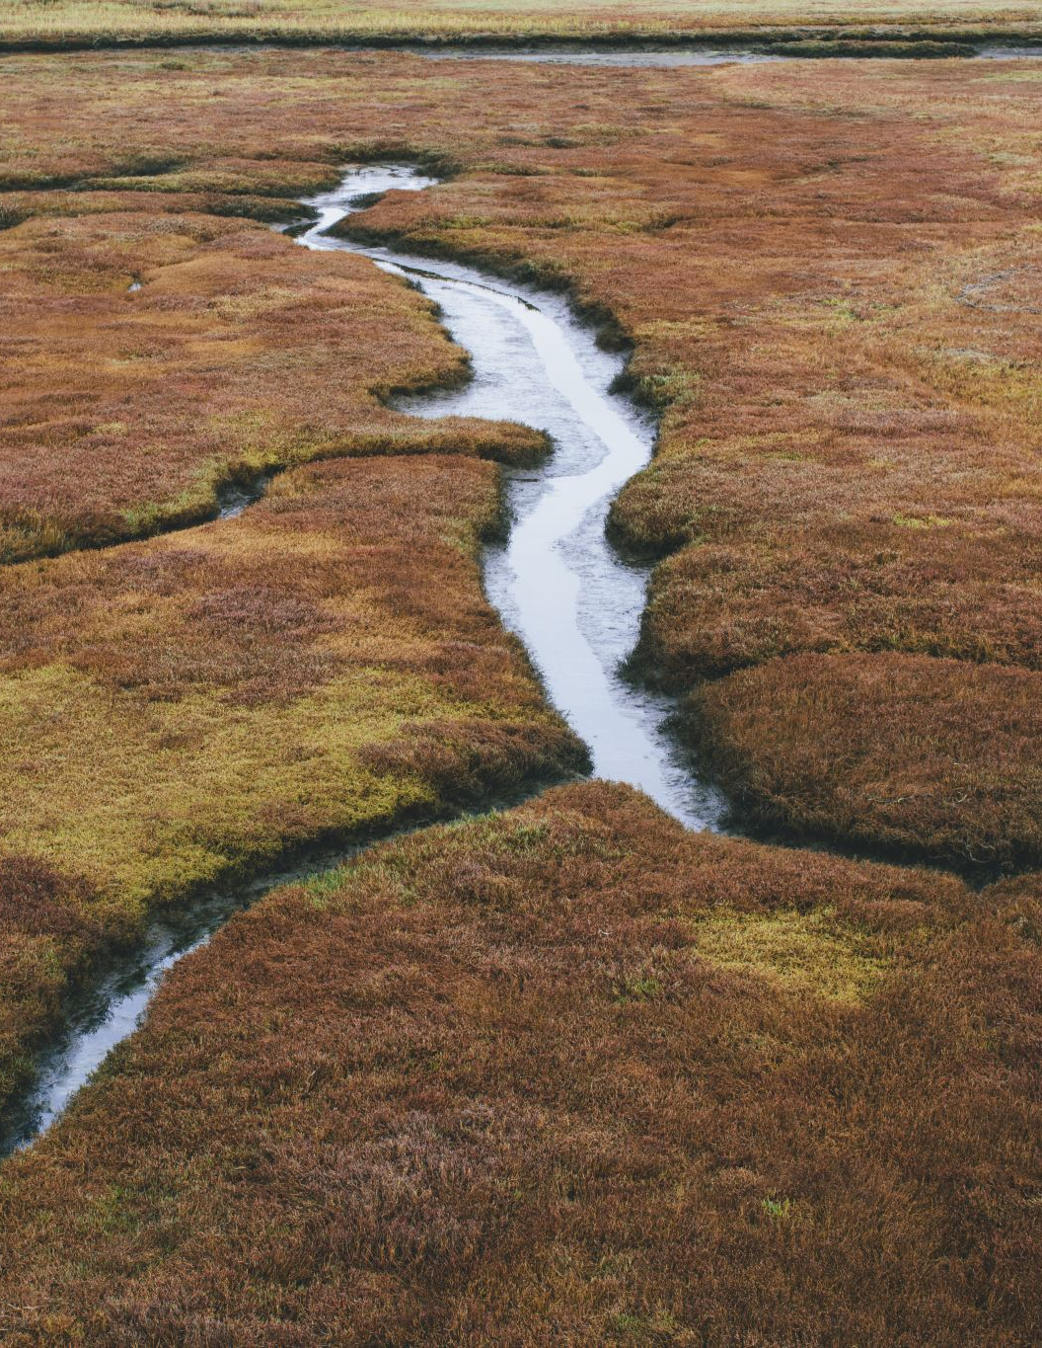
Challenges
Forecasting Shorter Times
Urban Areas
Forecasting Longer Times
Near river basin areas.
Notes:
There are major challenges identified in the study area .
Flood Forecasting Shorter time
example:- Urban Areas.
And
Flood for casting for Longer time.
example:- River Basin Areas.

Slide 23

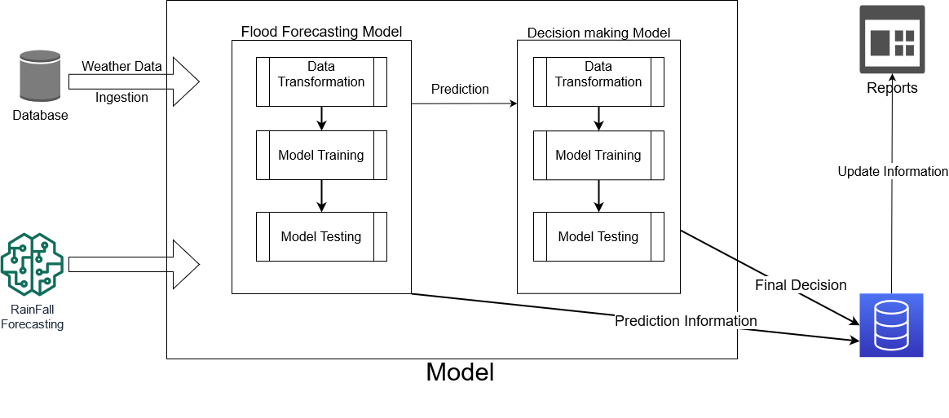
Model Design
Notes:
This is model design on of Water level forecasting and decision-making model with using of rainfall-forecasting model and historic data of the location.

Slide 24
Water Level Forecasting Model Methodology
Data-mining
River data from Irrigation Department.
Daily levels Database
Data Reports from DMC (Disaster Management Centre).
Daily Reports Database
Representation
Dashboards
Notes:
Water Level Forecasting model methodology consists of
Data mining daily from these sources .
Predicting Classification.
Re presenting

Slide 25
Data used
Water Levels of change in river on time basis
Water levels in a specific station.
Rainfall model prediction’s data
River Basin
Fluctuations

Slide 26
Decision Making Process
With Summarized Data
Big Data
Summarized Data
Classified Judgement (Human)
Final Decision (Ai)

Slide 27
Decision Making Model Process
Data Sources :-
IoT sensor live feed.
Ultra-Sonic Sensor Reading.
Temperature
Relative Humidity
Rainfall Prediction value at the time.
Water Level Prediction Model Classification value at the time.
Notes:
Moving on to Decision Making Process,
We used
IoT Live feed from
Ultrasonic Sensor
Temperature
Relative Humidity
Rainfall Prediction value at the time
And finally, the water model classification

Slide 28
Decision Making Model
Water Model Classification
IoT Sensory Data Classification
Final Decision
Crowdsourcing Classification
Notes:
This is how the Urban and River side flooding decision was provided with K-Means Clustering from Crowdsource and IoT Sensory Classification.

Slide 29







Techniques and Technologies
PCB Designing
Altium Designer
Machine Learning Frameworks
Scikit Learning
Keras
Programming Language
Python
Java
Database
Firebase

Slide 30
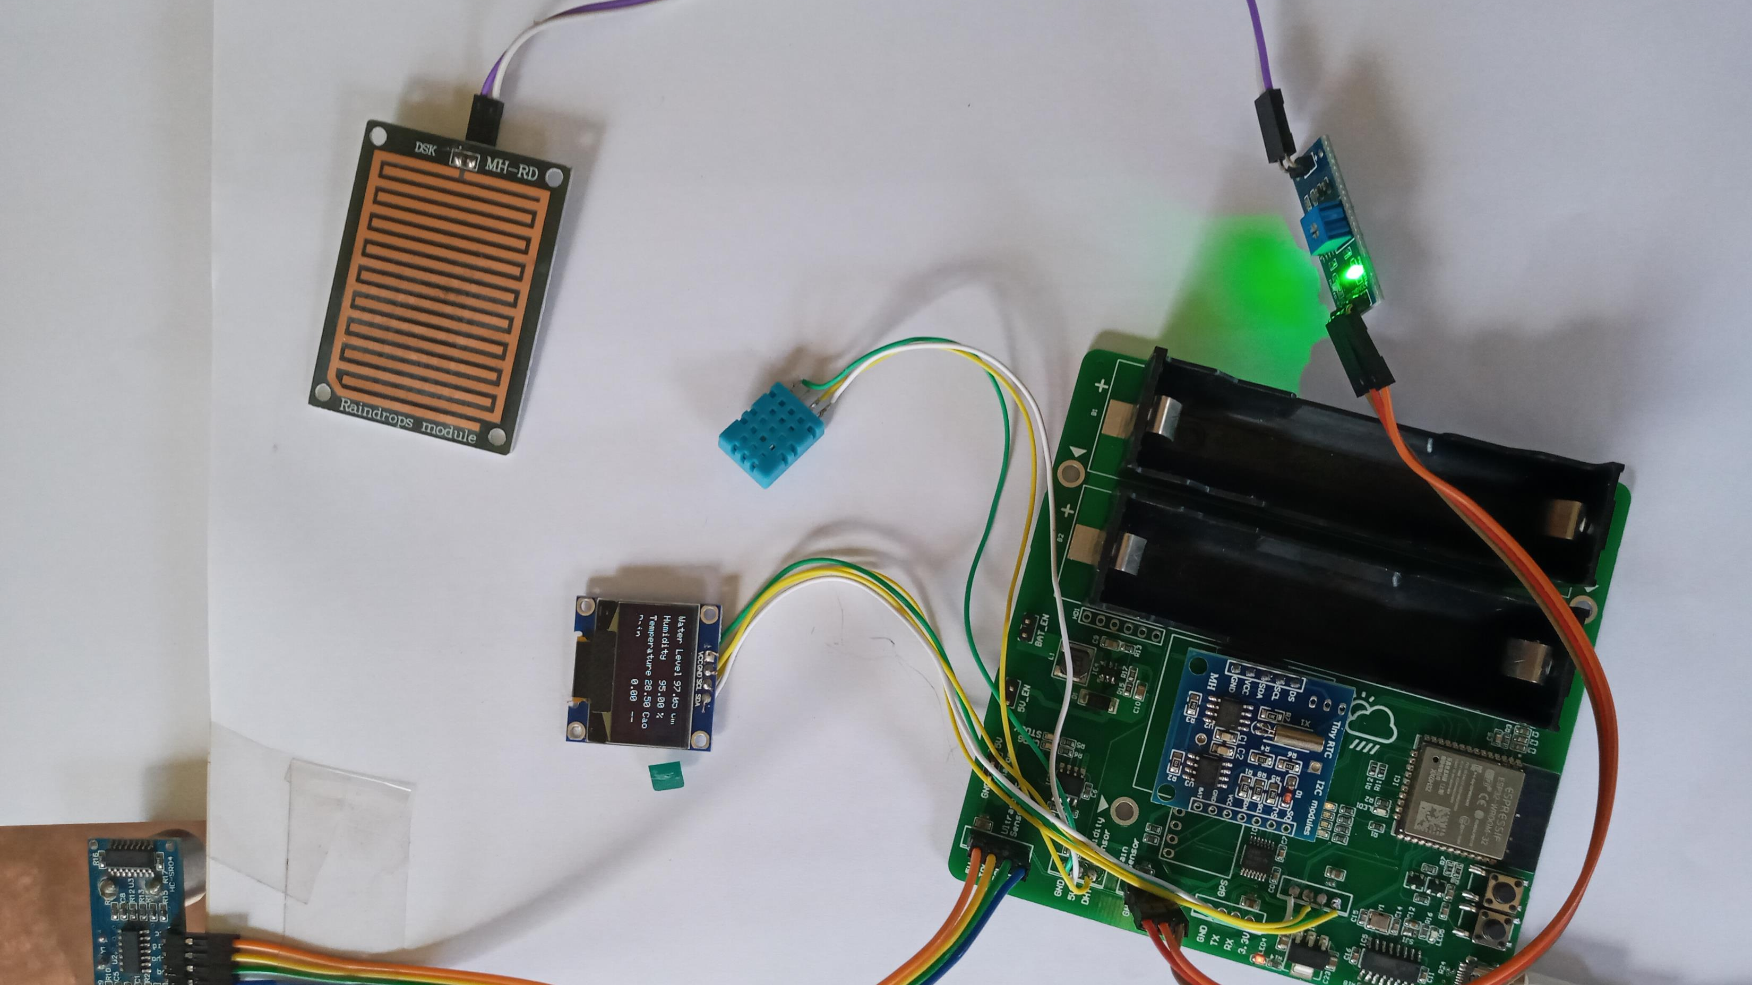
Research Results
IoT Device Unit (ESP32)
PCB Board Design
Temperature and Humidity Sensor
Rain sensor
Ultra-sonic sensor
Notes:
Now, Lets talk about or Research finding
We used Altium Designer to design PCB Board Design with incorporating these sensor.

Slide 31
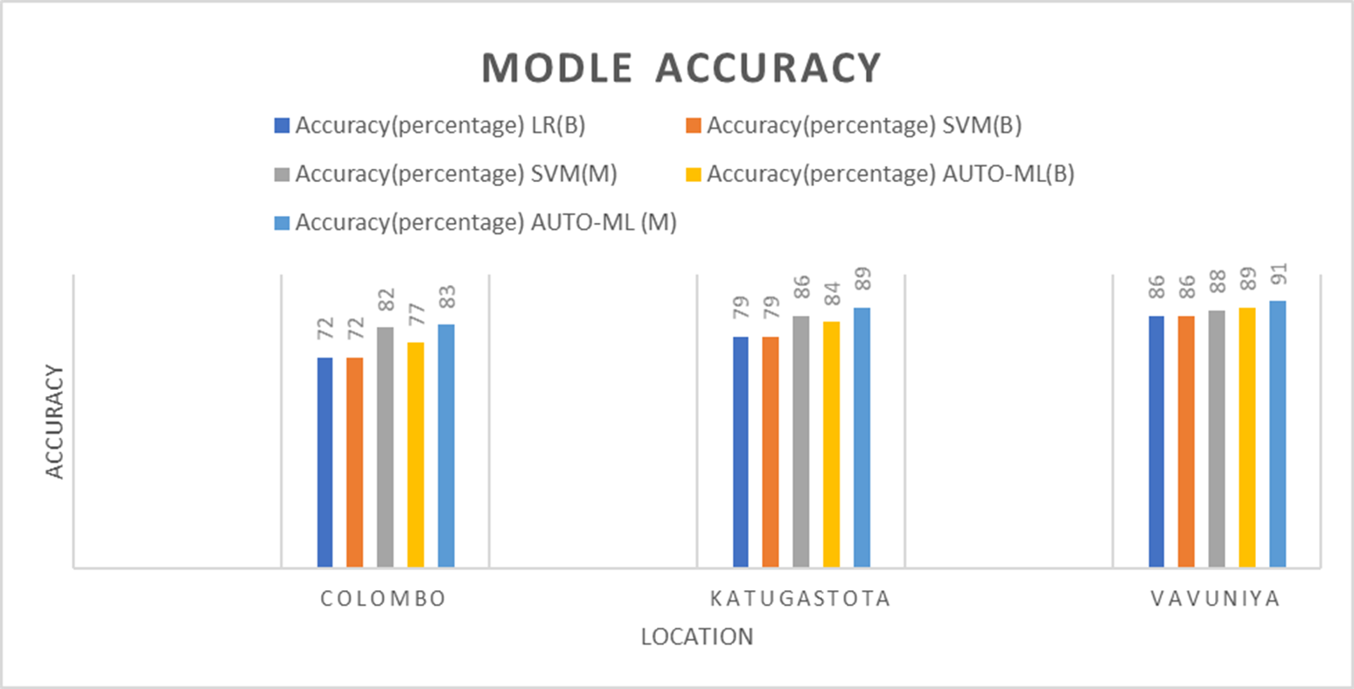
Research Results Rainfall Model Accuracy
Notes:
And this our rainfall model accuracy percentages for 3 Locations using machine learning models of Learner Regression SVM and
, Auto-ML machine learning models.

Slide 32
Flood forecasting Models Accuracy
Research Results
Accuracy table of water prediction models
Accuracy table of decision-making model
Data | Accuracy(percentage)
 | SLR | SVM | ANN
Train | 81.2 | 79.4 | 89.01
Test | 79 | 77.0 | 84.3
Data | Decision Tree (Random Forest)
Train | 50.4%
Test | 52.4%
Notes:
These are Flood Forecasting model accuracies .

Slide 33
Conclusion
The contribution of each attribute to rainfall changes across locations.
Regardless of the location of the gauge station, the accuracy of the test data does not vary.
Data-driven solutions are highly dependable on data quality and, therefore, advanced data collection and analysing methods should be carried out.
Weather forecasting efficiency can be improved by collecting more factors from the crowd.
Notes:
Our conclusion is that,
Contribution of each attribute to rainfall changes across locations.
Regardless of the location of the gauge station, the accuracy of the test data does not vary.
Data-driven solutions are highly dependable on data quality and, therefore, advanced data collection and analysing methods should be carried out.
Weather forecasting efficiency can be improved by collecting more factors from the crowd.

Slide 34
Future Work
Conducting In-depth analysis of crowdsourcing data with images classification.
Collected crowdsourcing data to be use for post flood relief work efforts.
Incorporating a GSM module and adding other sensors to gather weather factors to improve model performance.
Notes:
Our journey doesn’t end here.
The future works will be
Conducting In-depth analysis of crowdsourcing data with images classification.
Collected crowdsourcing data to be use for post flood relief work efforts.
adding GSM module and other sensors to ingest weather data, to improve the performance of the models.

Slide 35
References
[3] G. Q. Daniele Mezzana, “Crisis mapping and crowdsourcing in flood management,” Integr. Flood Manag. Tool Ser., vol. 26, no. 1.0, pp. 1–90, 2017, doi:10.13140/RG.2.2.35313.07527.
[4] M. Djordjevic and D. Dankovic, “A smart weather station based on sensor technology,” Facta Univ. - Ser. Electron. Energ., vol. 32, no. 2, pp. 195–210, 2019, doi: 10.2298/fuee1902195d
[1] K. Ramanayake, D. Vithanage, N. Hettiarachchi, G. Rathnayake, S. Rajapaksha and N. Fernando, "Geo-enabled FOSS tool supports for immediate flood disaster response planning," 7th International Conference on Information and Automation for Sustainability, 2014 .
[2] H. Thilakarathne and K. Premachandra, "Predicting Floods in North Central Province of Sri Lanka using Machine Learning and Data Mining Methods," Research, 2017.
Notes:
So, these are our references used in our slide

Slide 36

Thank You!
More Info
Notes:
Thank you!

